Slide 1
CSC741 Digital Image Processing Presentation 3
Jessica Gallo & Alex Liew

Slide 2
Introduction
Part 1: Jessica Gallo: Thermal Images
Gamma Corrections
Alpha Blending
Contrast Enhancements
Image Distance Measurements
Euclidean, Mean Square Error, Peak Signal to Noise ratio
Part 2: Alex Liew: Plant Pathology Images
Image Sharpness / Contrast Measurements
EME mapping of local regions
More Contrast Stretching
More Gamma Corrections
Flow diagram of our System so far

Slide 3
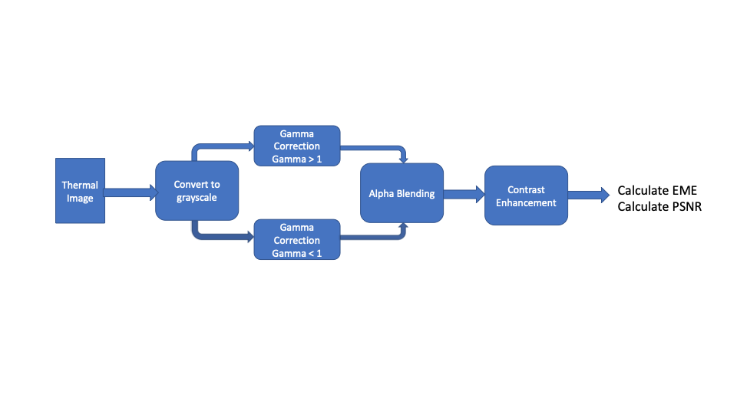
Calculate MSE
Calculate PRSN
Calculate Euclidean Distance

Slide 4
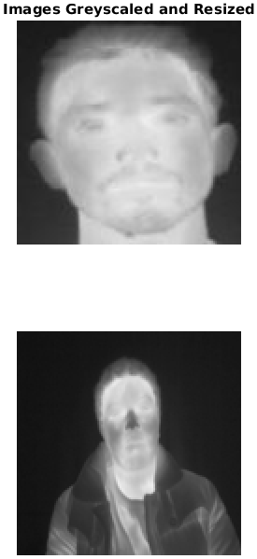
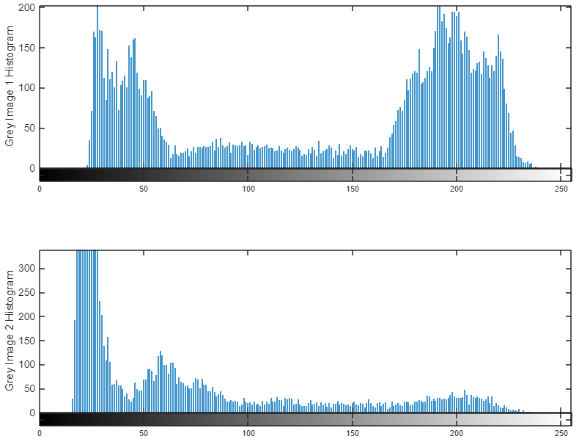
Original Images Resized & Histogram
Resized to 120x120

Slide 5
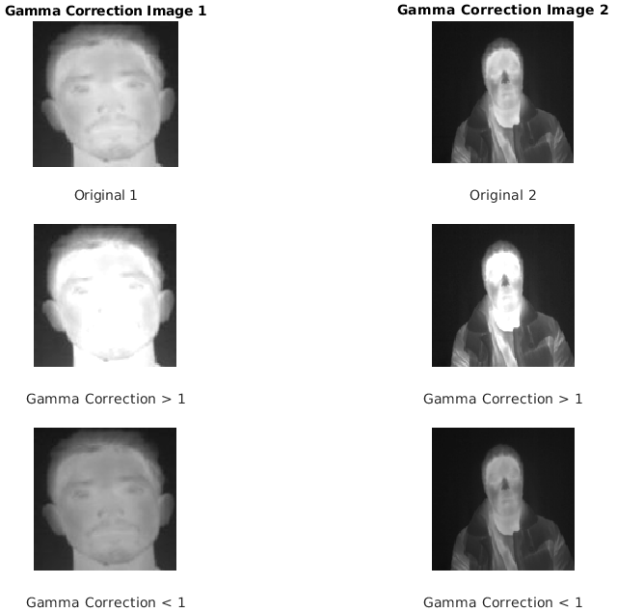
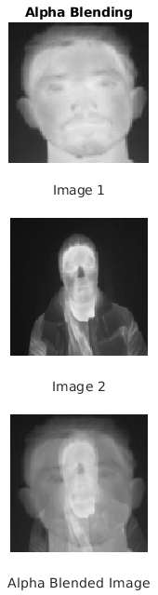

Gamma Correction & Alpha Blending
Gamma = 1.05
Alpha = 0.6
Gamma = 0.95

Slide 6
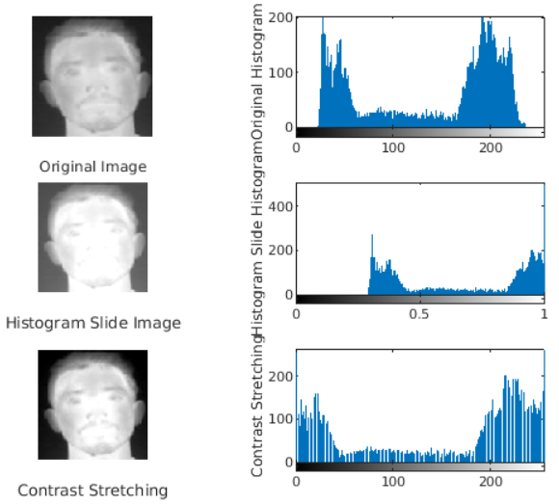

Piecewise Contrast Stretching & Histogram Sliding
Added brightness = 0.2
T=+20
[0.5, 0.95]
5% darker & 5% brighter

Slide 7
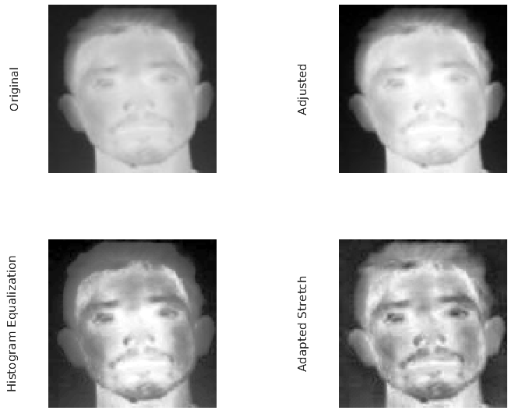
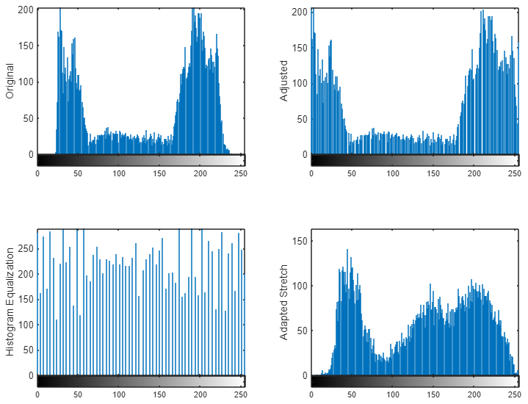
Adjust, Adapted Stretch & Histogram Stretch

Slide 8
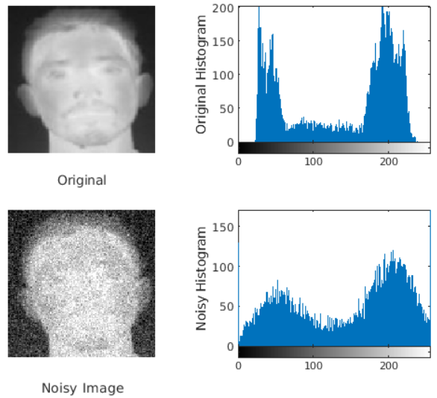
Noisy Image
Gaussian Noise = 0.04

Slide 9
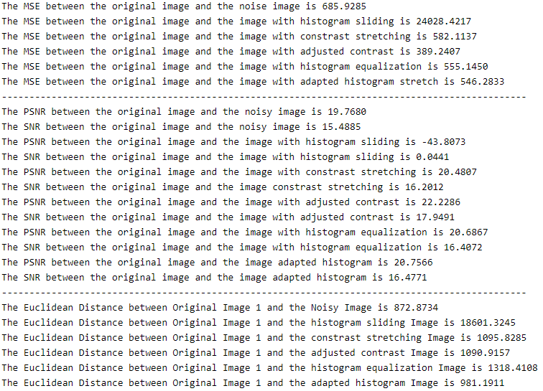

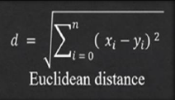
MSE, PSNR & Euclidean Distance
Best Results

Slide 10
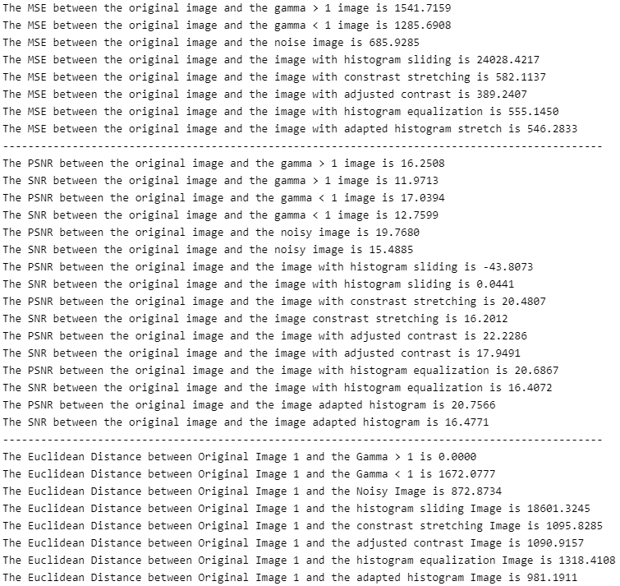
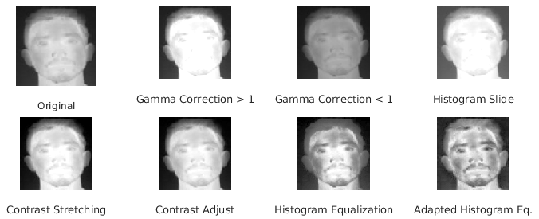
MSE, PSNR & Euclidean Distance
Best Results

Slide 11
Comparison

Slide 12
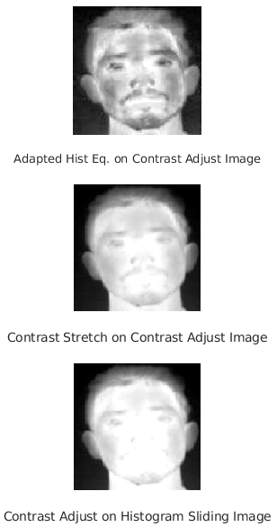
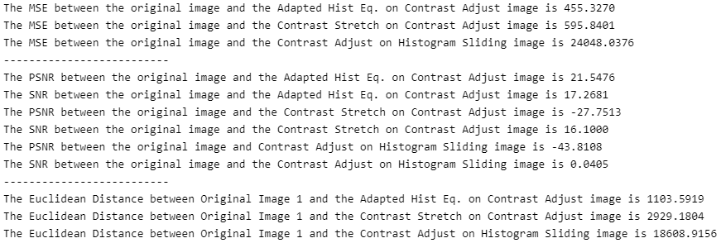
Experiments

Slide 13
(1)
Suppose that you had a scene of three objects of different distinct intensities against an extremely bright background. What would the corresponding histogram look like.
Ref: https://www.cse.usf.edu/~r1k/MachineVisionBook/MachineVision.files/MachineVision_Chapter3.pdf (p. 81)
How could you get a program to automatically work out the ideal threshold for an image from its histogram? What do you think might be the problems?
One way you can get a program to automatically work out the ideal threshold for an image form its histogram is with Otsu Thresholding. Problems with this method are that it is mostly useful on bimodal histograms, assumes stationary statistics, and assumes unform illumination.
Ref: http://www.math.tau.ac.il/~turkel/notes/otsu.pdf
If there is a very high peak right at the top end of the histogram, what does this suggest?
If there is a very high peak right at the top end of the histogram, this means that the pixels are mostly bright.

